Slide 1

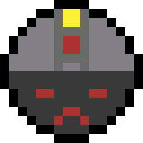
By matthew law

Slide 2
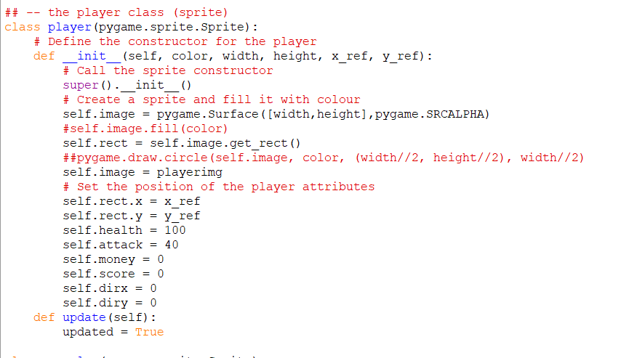
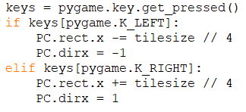
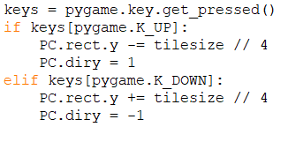
Task 1:
As the basic setup task started with the setup of a 1000p x 1000p screen, and my screen is smaller than that ( meaning I had to do all the developing on a 500*500 screen), I knew I had to make a more modular, easily resizable game, as I can demonstrate by changing the size of each tile on the fly. I did this by using a “tilesize” variable at the start of my code, which I then built the rest of my code around, basing all the measurements and speeds off that variable
In addition, I made a new player class ,which only contained the code for initialising the class, and the rending of its sprite
This then allowed me to control movement outside of the class, and made handling collisions easier and cleaner in the long run, as I will demonstrate in task 2
I deliberately left my player class as barebones as possible, as I didn’t want it to become too convoluted, and slow down the rest of the game
However, at the time I thought that you had to call an update method on each sprite or the game would crash, hence the “updated = True”

Slide 3
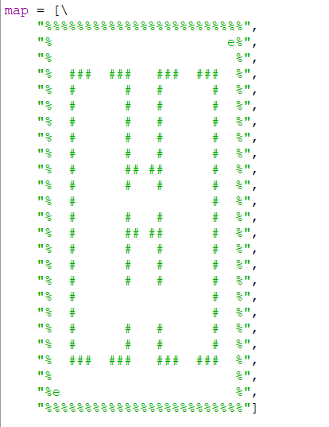
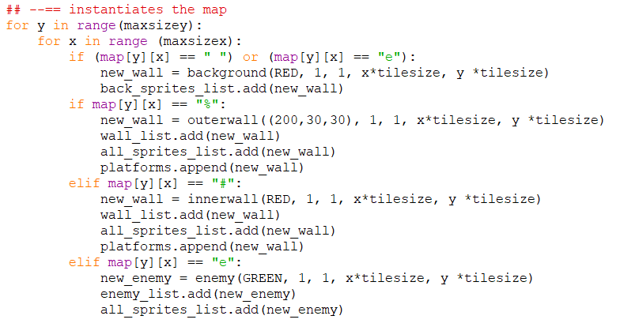
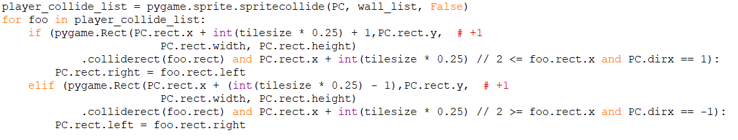
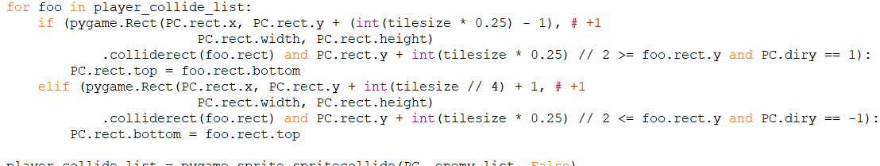
Task 2:
Adding walls came in two primary stages:
Adding a way to quickly design and instantiate maps
Adding collision on the walls to prevent the character from moving out of bounds
First I used a relatively efficient way of handling maps, which is to store the map into an array of strings, with each character defining a different block to instantiate, I would then loop through this string, with the coordinates for x and y inverted (because python works in mysterious ways), and put in what I needed at each coordinate, which was calculated by multiplying the x and y location of the block in the array by the tile size defined at the top of the script
Collisions were quite a headache in this game, but I figured out a relatively efficient system, which checked the current location of the player, and used a series of checks on where the player was in comparison to the wall, and whether the projected rect of the player in the next frame overlapped into the wall, followed by a final check on if the player was moving in the direction of the wall, which is defined by “xdir” and “ydir” in the movement script, player_collide_list here was defined before these extracts as follows:

Slide 4
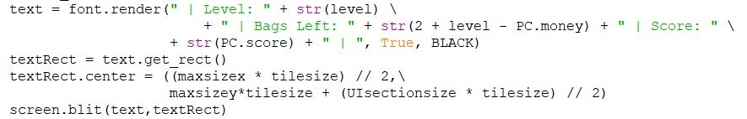
Task 3:
Adding text was one of the easiest parts of this games development, as it could be sorted using about four lines of code in total, as I had already defined the variables I would be using, however in order to accommodate the new UI area, I had to increase the height of the playspace by a variable “UIsectionsize”, which was defined at 5 tiles big, and sits at the bottom of the screen.
To add the text, you have to have a few specific prerequesits, you have to define the font and textsize of the desired font as shown in the line of code above, before using it in the game, and then you have to define:
What the text contains
Where it is on the screen
Then finally blit it onto the screen (draw it)
The variables shown here (PC.score, PC.money are defined in the Player character’s (abbreviated in my code to PC) constructor

Slide 5

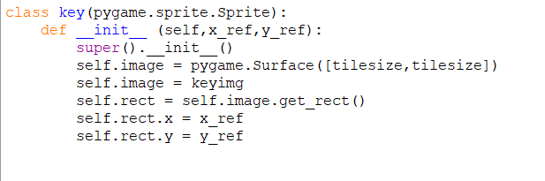

Task 4 + 5:
Adding enemies was actually as easy, if not easier, as implementing walls as this stage, as their class was basically the same, and I simply had to put an “e” on the map, and a new elif clause to fully detect and instantiate the new enemies,
I then could simply handle the collisions of the enemies at this stage with the following code:
This works by first detecting each frame if the player is touching an enemy, and then as the destruction flag is set to False, keeps it there and moves onto the next line, although by setting this flag to true you can destroy objects upon touching them, as I did with the collection of keys (which turned into money bags in my visual rework)
Then it loops through this list of enemys and detracts health from the player and enemy (defined by foo here) until one of them dies, although I scrapped this system in favour of a more “stealth game” type system during my visual rework
The system to spawn in keys once an enemy was also quite easy, although since I scrapped the system there is no longer demonstrative code snippets, in order to do this, I made is to the enemy checks its health every frame, and if it falls too or below zero, it destroys the enemy with enemy.kill() then instantiates a key from the class key where its coordinates were, and adds it to a special group (key group) which could then be used for specialised collisions, similar to enemygroup

Slide 6
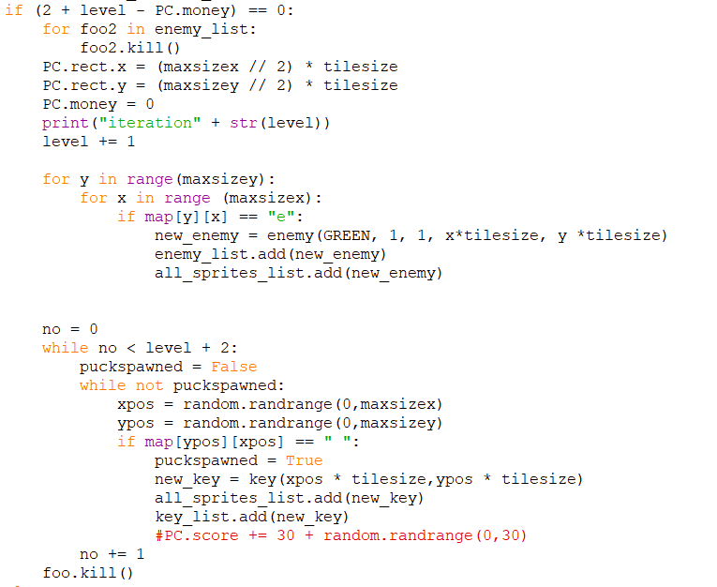
Task 6:
Level transitions were handled in a relatively simple way, in retrospect, although it took some planning to figure out what exactly I had to delete and redraw each time the level was regenerated:
Map blocks – could be left as I opted to keep the map the same with every level
Enemies – had to be destroyed and redrawn in their original positions
Player – could simply be moved back to the centre of the screen and had its keys reset by PC.coins = 0
Keys / moneybags – could be untouched, as they delete themselves if they are interacted with, although I had to redraw each round after the visual rework, as I decided to have the player chase the bags down while dodging the enemy
The deletion of old sprites could by handled by looping through the list and .kill()ing all the sprites within that list, and then the new sprites were redrawn in the same way as old ones
For simplicity, I decided to make the “stairs” that spawn in upon successful level completion use the same basic framework as “keys”, however I added a check in the key collide area to see if all the keys / moneybags were collected , at which point once the stairs are touched it generated the new map (puckspawned is used here as “puck” is the standardised name for a collectible object I use in most games)

Slide 7
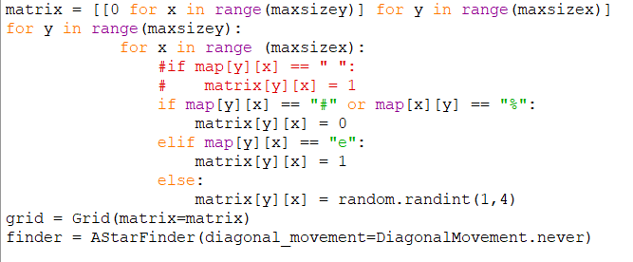
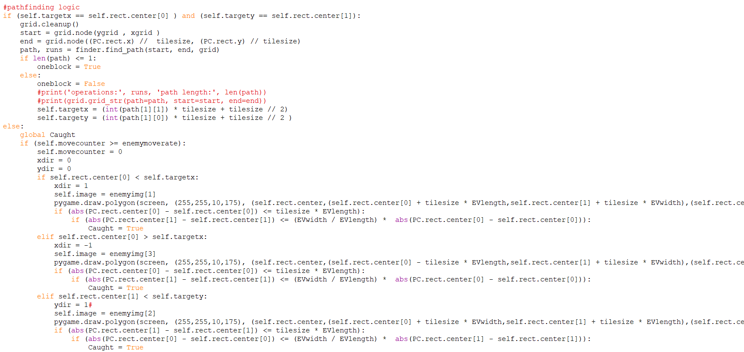

Extension Task 1: moving enemies
Moving enemies and the “AI” it involves is always the hardest, and most painful part for me, although using a modified version of the A* algorithm it can be done relatively efficiently,
I do this by first looping through the map and setting up a “grid” of nodes that the enemy can and cannot move through, with “0” being an obstacle, and then from there 1 being the easiest squares to go through and any higher being harder to get through
I would then use this to generate a new path for the enemies, although generating paths is very rescource heavy, so I (whenever I generate a new path) take the first block in that path the enemy has to travel down and set it as a target coordinate, that the enemy can move towards, and then once the enemy reaches this block, which it does by seeing where it is in relation to the coordinates and just shifting its position towards it, a new path is generated, a new block is chosen and the whole process starts again until the player is caught, although this system does has some downsides, as the generation of each new path from the enemy produces a slight lagspike when it is happening
The drawing lines here that go off the side are how I draw the spotlights, and can be ignored at this stage

Slide 8


Extension Task 2: Visual Overhall
Since at this point I had done all the core mechanics for the game I decided to have a slight visual overhall, which then transitioned into a full game rework, as I wanted to move away from the more “RPG” luck based elements, to a more stealth based type system as I had never done it before
All my sprites are always drawn up in asesprite, as its workflow is quite simple, and then exported as a png, which I can then call into python with the following line of code
However, depending on the desired effect of the sprite, this code must be modified, if the sprite needs to have a transparent background, the .convert() must be removed, however this causes more lag so should not be overused, then after that is the resize conditions, and define how big the sprite must be in the game, for example with the sprite I used for the main menu I had to make it the full size of the screen, however with example of the player sprite, I had to make it the size of only a single tile.
From there applying the sprite was (relatively) easy, as I could set the image of the pygame sprite to the imgae I had drawn, however for directional sprites such as the enemies, I had to define the image as an array of images, which then could be taken from depending on which way the enemy is facing
As I decided to go for a “stealth” type game, I decided to make a screen overlay which darkened the view outside of a certain radius of the player (defined a the top of the code as Pview for easy adjustment on the fly), which I did by making a new sprite that was drawn on top of the whole screen, and then drawing a circle onto it of radius Pview, which has an alpha of zero, essentially acting as a cutout mask for the darkening mask
The most difficult part of this new system was the drawing of the enemy torches, and the collision that came with it, but I came up with a system that used a length and width defined at the top of the code, and then drew a triangle of those dimensions in the direction the enemy was facing, and then the flashing effect was added by making this draw happen on only about ¾ of the frames of each second, the collision was done by first seeing if the player was in range of the torch’s length, and then checked how far it was away, and using the equation distance from centre = (width / length) * distance from enemy, could check if the player was within the area of the torch and kill the player, ending the game ( I have cut off the definition for the final node of the triangle in the screenshot because otherwise it simply would not fit on my screen)

